Slide 1


Investigation of Vulnerabilities in Open RAN Implementations
Research Project – WS 22/23
Arnova Abdullah
Weekly meeting-11 (11.01.2023)

Slide 2
Previous Weeks Meeting Details
Week 1 Meeting (19.10.2022)
Basics about Radio Access Network (History, parts of RAN for 1G, 2G, 3G, 4G)
Basics about Open RAN (Distribution unit, central unit, user plane, control plane, interfaces, front haul, mid haul, backhaul)
Open RAN risk analysis (Stakeholders of attackers-User, external attacker, cloud operator**, RAN operator**)
Week 2 Meeting (26.10.2022)
Installation of Kali Linux and Metasploitable
Atomic Red Team GitHub repository download
Research other open-source attack tools
Week 3 Meeting (02.11.2022)
Penetration testing using Kali Linux
Try Atomic tests by invoke-atomic
Get used to commands used for running a test
Research details about one of the attack tools - Infection Monkey
Read research papers on the risk of 5G open RAN
Week 4 Meeting (09.11.2022)
Finding the most relatable attacks from the MITRE ATTACK list (On going)
CyberOps course ongoing
Research paper by MOU

Slide 3

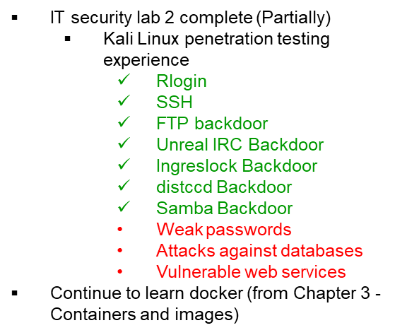

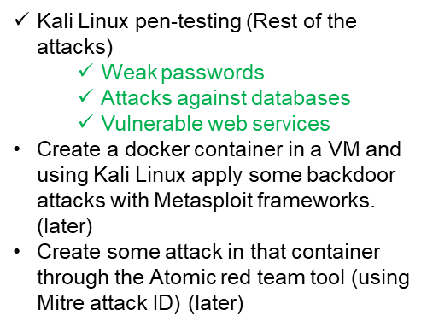
Previous Weeks Meeting Details
Week 5 Meeting (17.11.2022)
Install Infection monkey (Need AWS subscription, don’t continue anymore!!)
Start learning Docker container
https://developer.cisco.com/learning/tracks/containers/
https://learning.oreilly.com/videos/docker-fundamentals-for/9781803237428/9781803237428-video1_1/
Week 8 Meeting (08.12.2022)
Make a comparison between Kali Linux tools and Atomic Red Team
Select one to use at the end of the project
Week 9 Meeting (15.12.2022)
No update

Slide 4
Previous Weeks Meeting Details
Week 10 Meeting (21.12.2022)
Research:
Is there a map between MITRE ID to CVE list?
In Kali Linux, is there any tool or settings to map CVE or MITRE ID?
Create an extended comparison between Atomic and Kali in MS Excel (Not done yet)
Create a list for Docker, and Kubernetes attacks:
How to attack the docker container? Which version?
What are the tools? (If required any)
What are the known vulnerabilities? (CVE, MITRE)
Create a list for Ubuntu:
Which Ubuntu version?
How to attack Ubuntu?
What are the tools? (If required any)
What are the known vulnerabilities? (CVE, MITRE)

Slide 5
Week 11 - Until 11.01.2023
Research more about Vulmap.
Which type of attack can it do?
Install it in Kali Linux and have practical experience with it.
Do the lab of Docker from DevNet.
If it is installed, then try some attacks with kali and atomic by mapping to CVE/MITRE. Use the list from the previous page list. (Partially done!)
Have some more practical experience with the Atomic red team.

Slide 6
Vulmap
Which type of attack?
Vulmap is an open-source online local vulnerability scanner project.
For Windows and Linux operating systems.
The main idea is to get real-time vulnerability data from Vulmon.com (instead of relying on a local vulnerability database).
Scripts
scan the localhost to gather installed software information and ask vulmon.com API if any vulnerabilities and exploits are related to installed software.
Even the most recent vulnerabilities can be detected.
Vulnerability assessment using scripts-
Its exploit download feature aids privilege escalation processes or DoS/DDoS attacks by Pentesters/red teamers.
Exploits can be downloaded with Vulmap from Exploit DB from the command prompt. (Only exploit ID is required)

Slide 7
Vulmap
What is Vulmon.com?
Vulmap is an open-source online local vulnerability scanner project.
For Windows and Linux operating systems.
The main idea is to get real-time vulnerability data from Vulmon.com (instead of relying on a local vulnerability database).
Vulmon is a vulnerability search engine with vulnerability intelligence features by Yavuz Atlas, Cyber Security Specialist – Pentester, Turkey. (https://www.linkedin.com/in/yavuzatlas/)
It conducts full-text searches in its database.
We can search everything related to vulnerabilities including CVE ID, vulnerability types, vendors, products, exploits, and operating systems.
A simple and comprehensive, easy-to-use tool for cyber security researchers.
Link: https://vulmon.com/

Slide 8
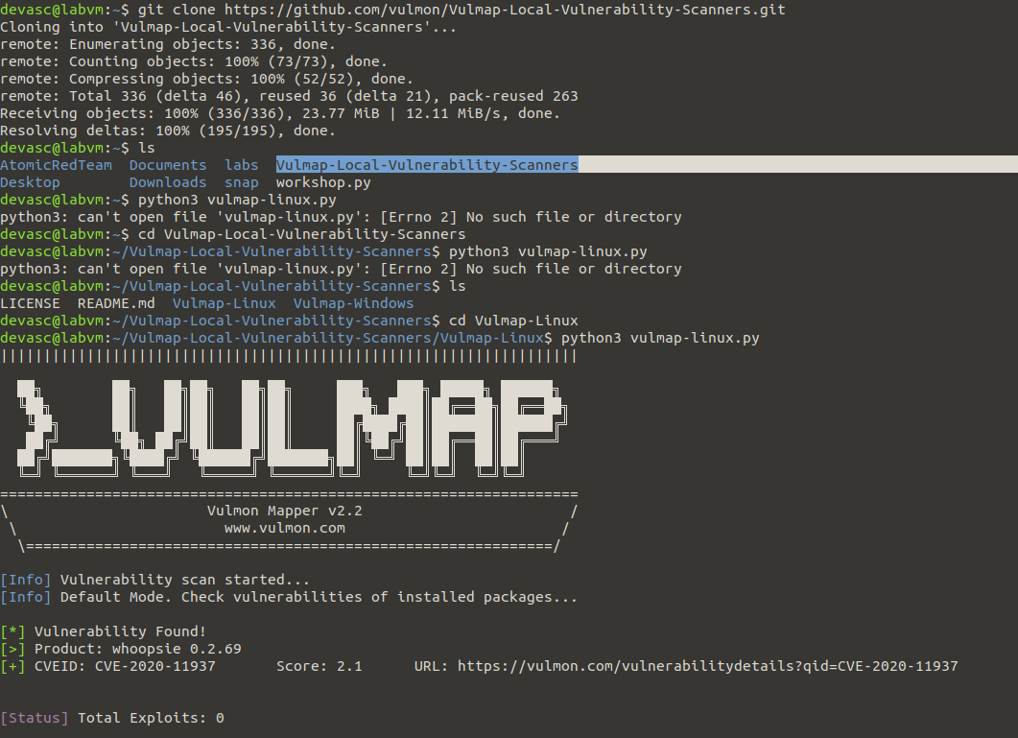
Vulmap
Installation
Vulmap in Linux: https://github.com/vulmon/Vulmap/tree/master/Vulmap-Linux
Scanning result with CVE ID

Slide 9
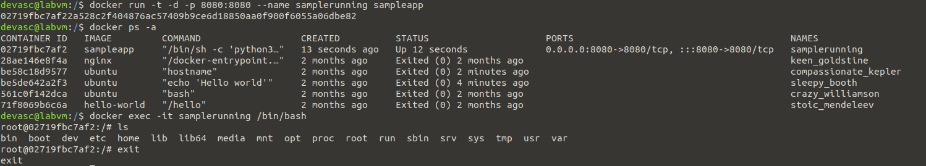
Docker
Installation using DevNet lab 6.2.7
Docker installation is done in DevAsc VM.

Slide 10
Next Steps (Week 12) Until 18.01.2023
Create a list of the MITRE ATT&CK ID by mapping to CVE ID
Follow the process described in https://github.com/center-for-threat-informed-defense/attack_to_cve/blob/master/methodology.md
Create your own environment with Ubuntu 20.04 and Kubernetes V1.16.0
Apply attacks with invoke-atomic with the MITRE ID mapped with CVE

